Slide 1
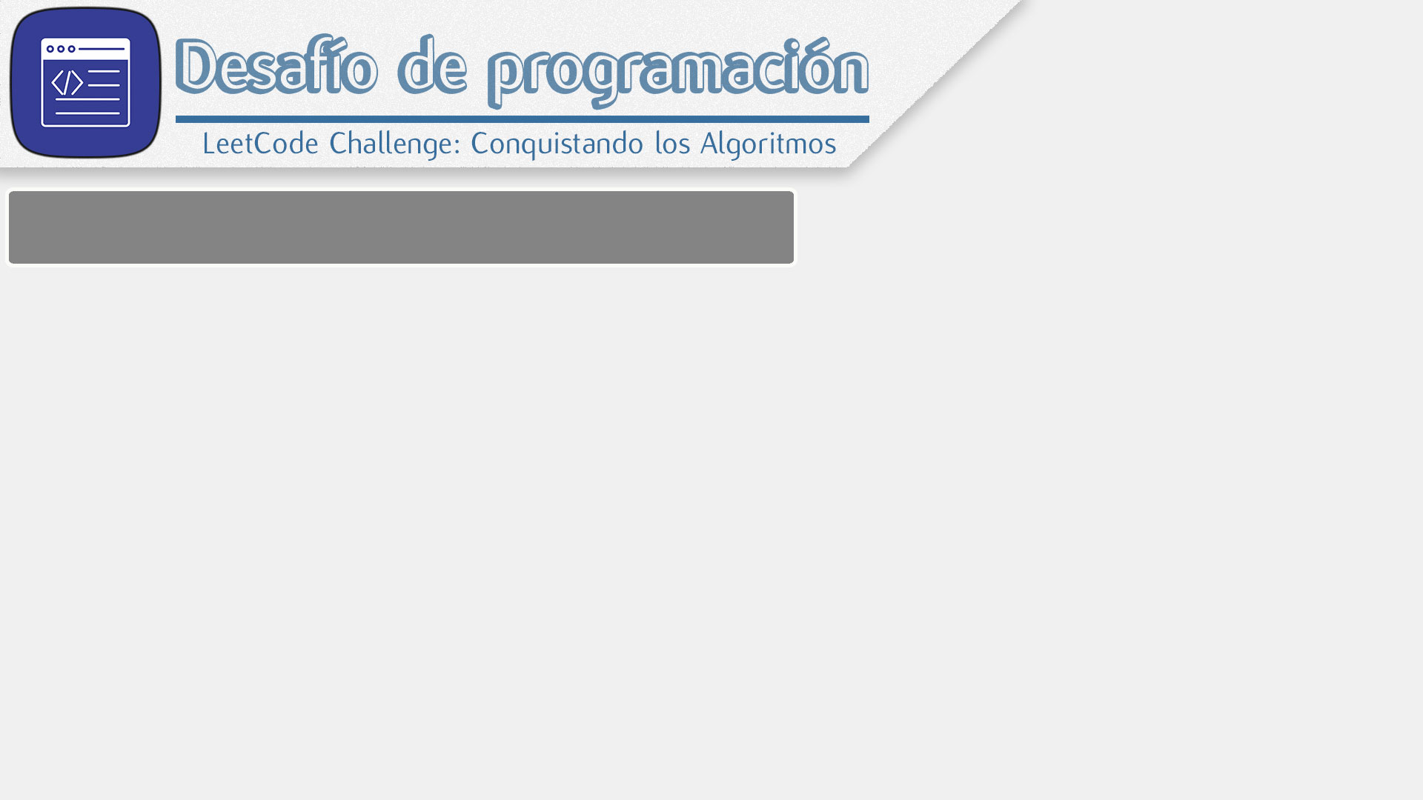

Slide 2


Slide 3
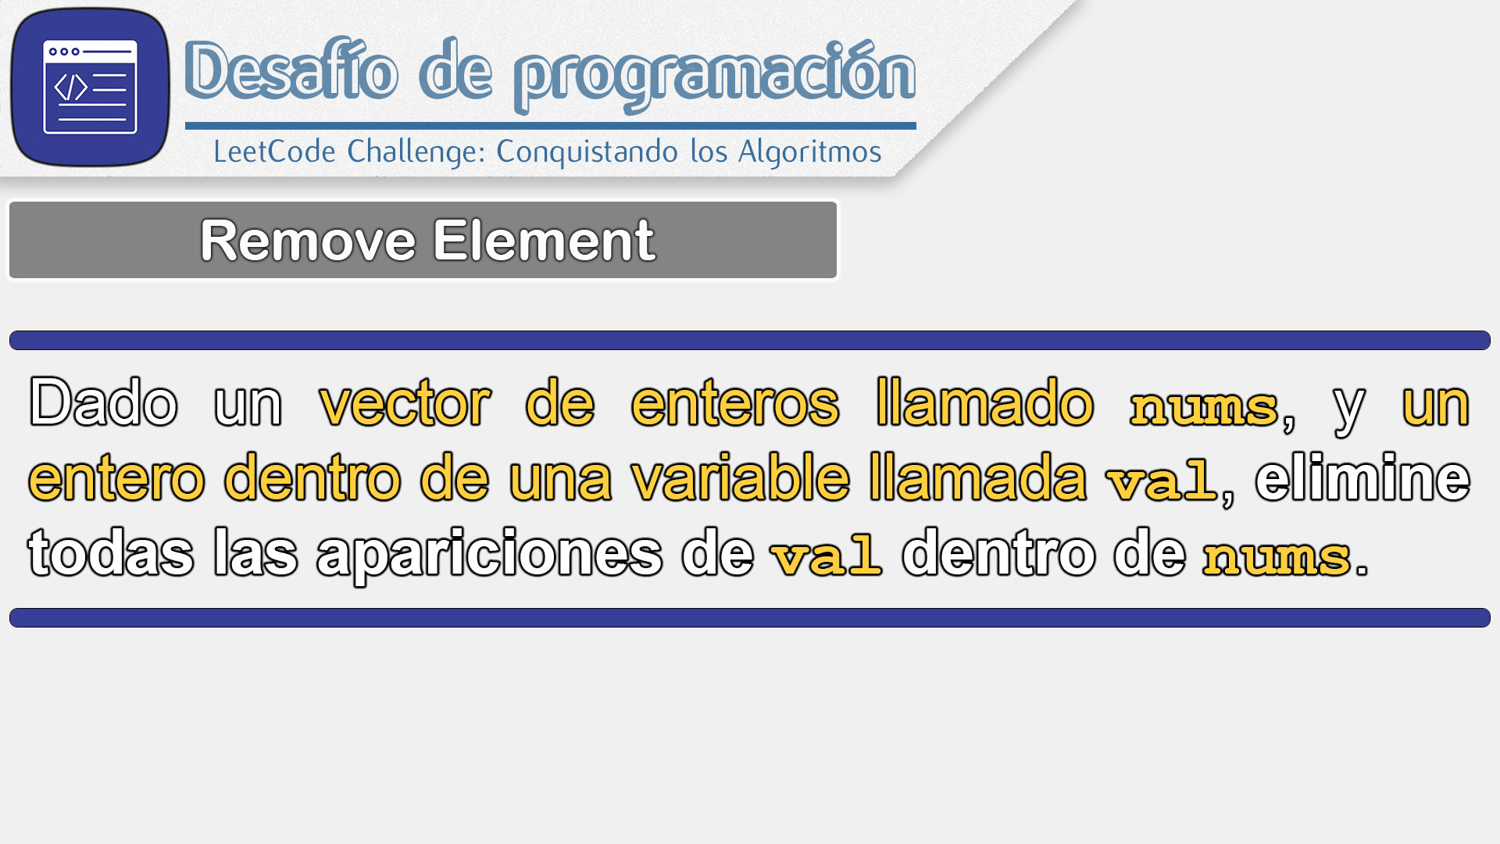

Slide 4
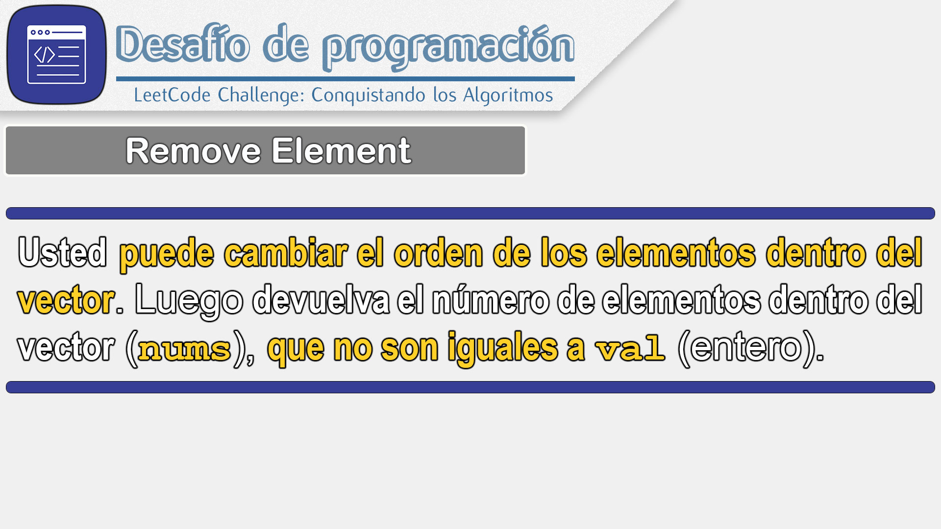

Slide 5
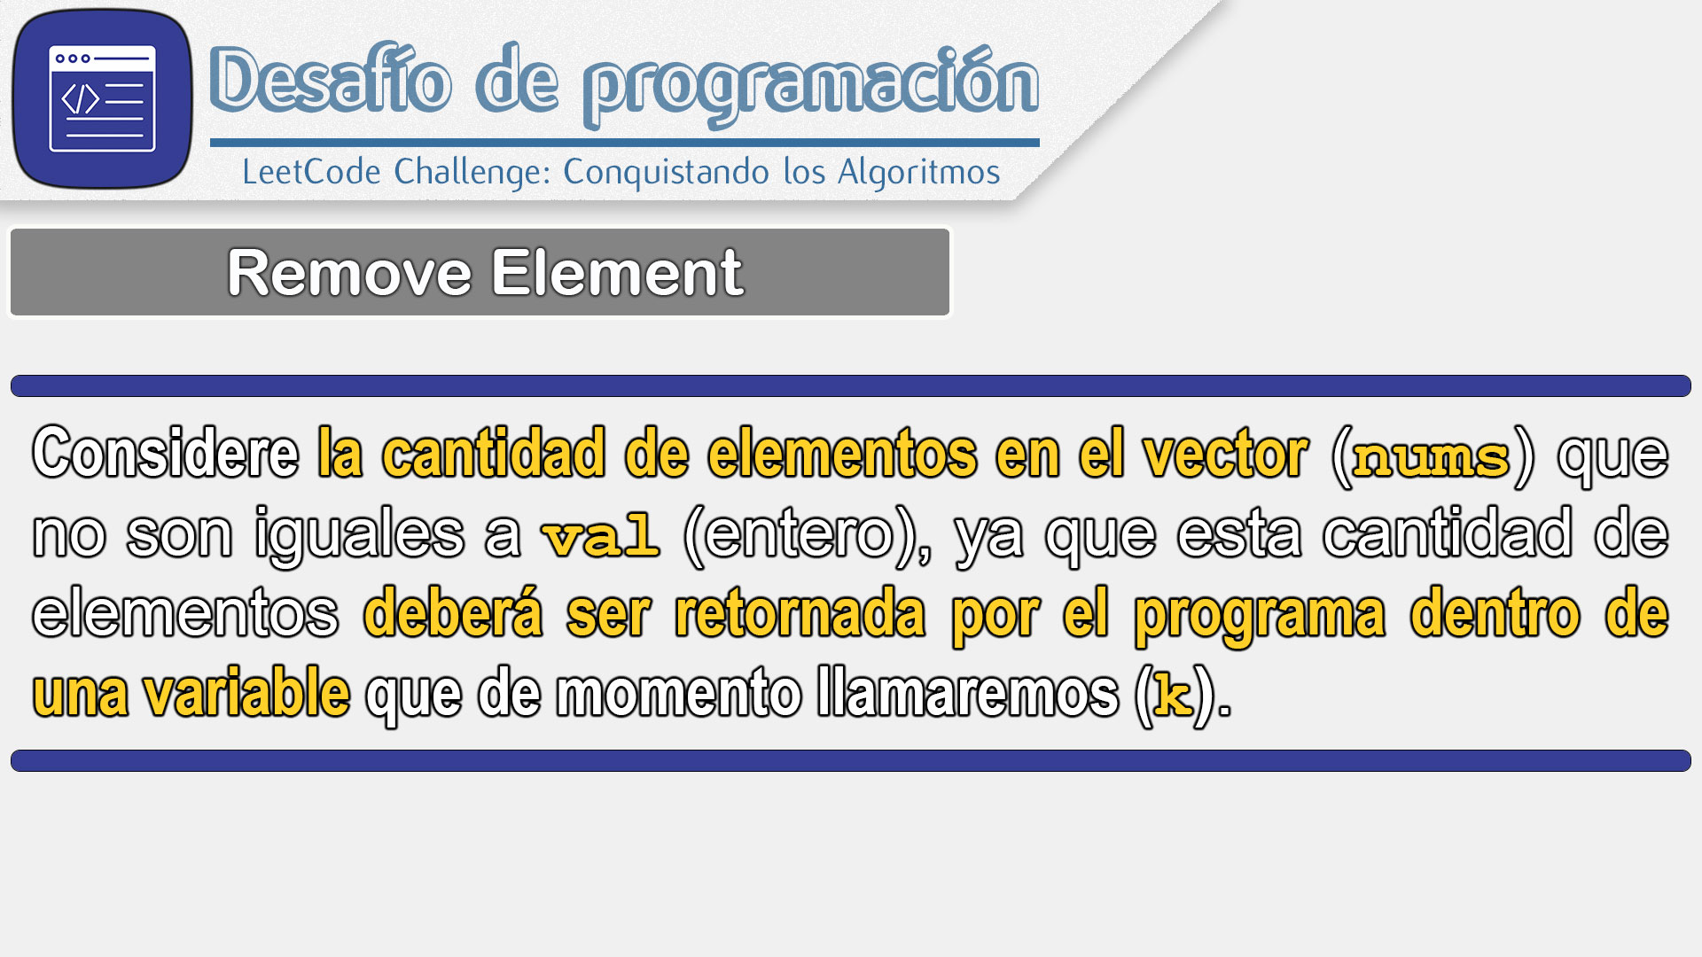

Slide 6
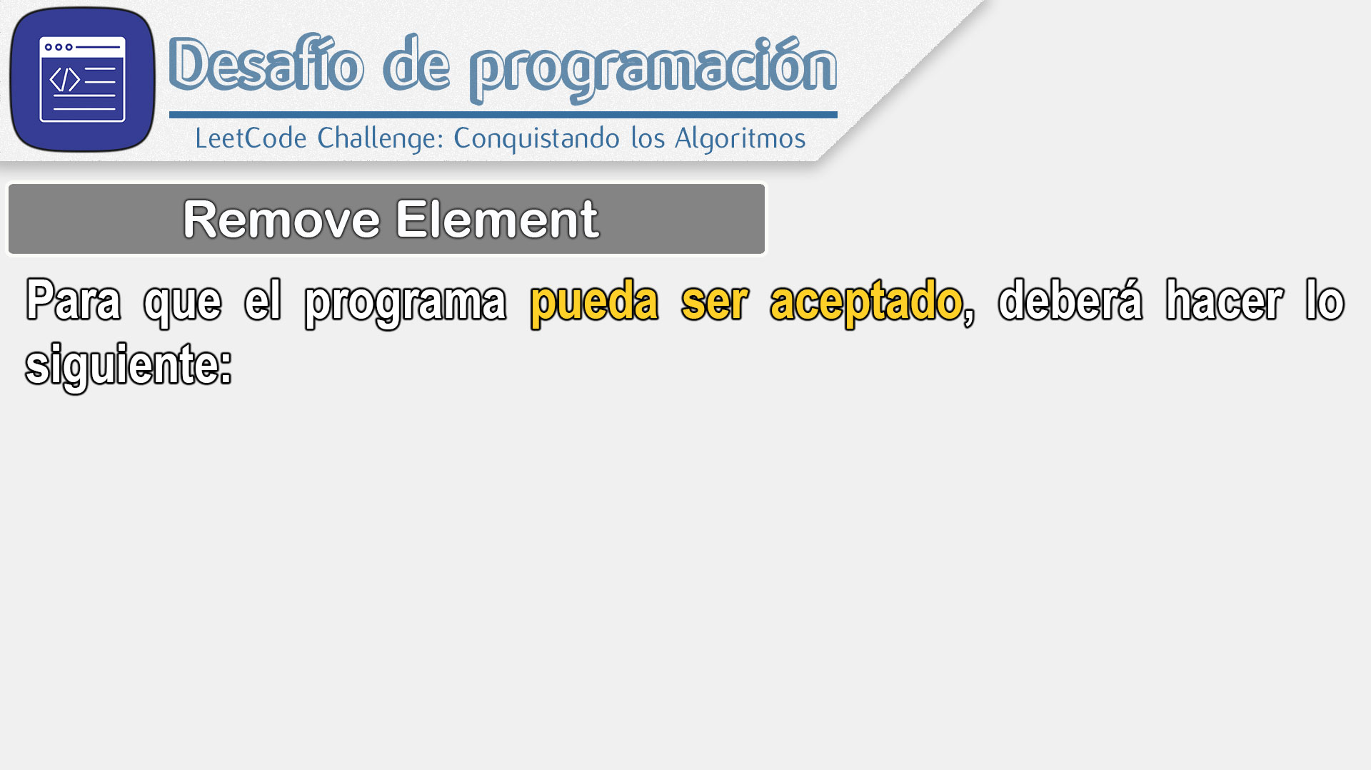

Slide 7
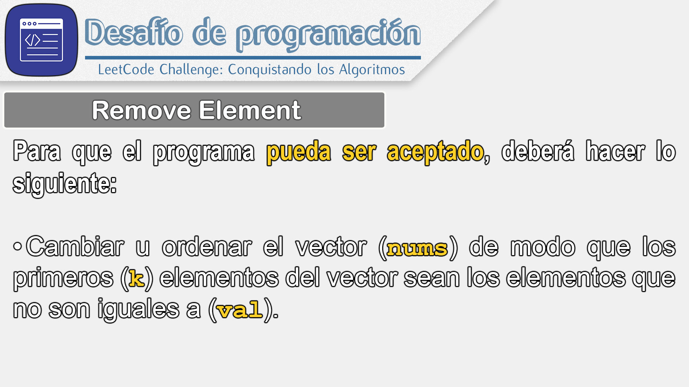

Slide 8
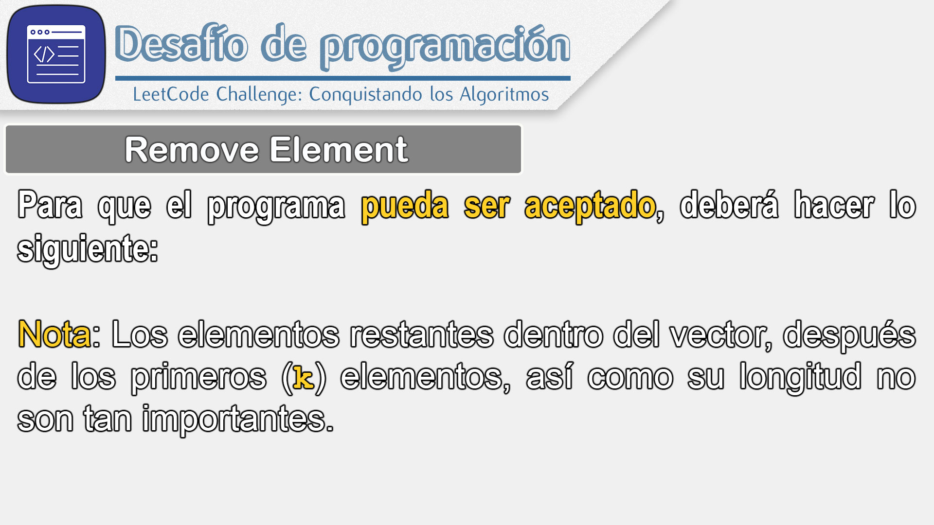

Slide 9
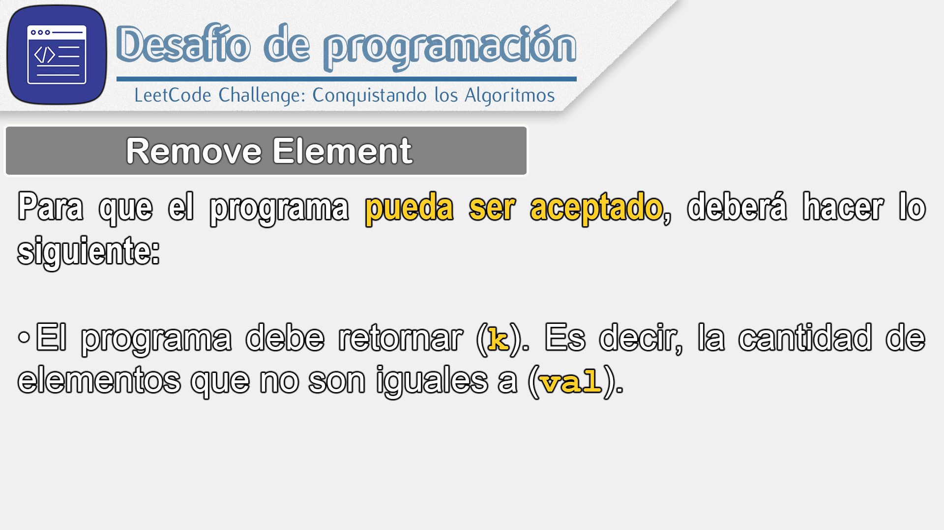

Slide 10
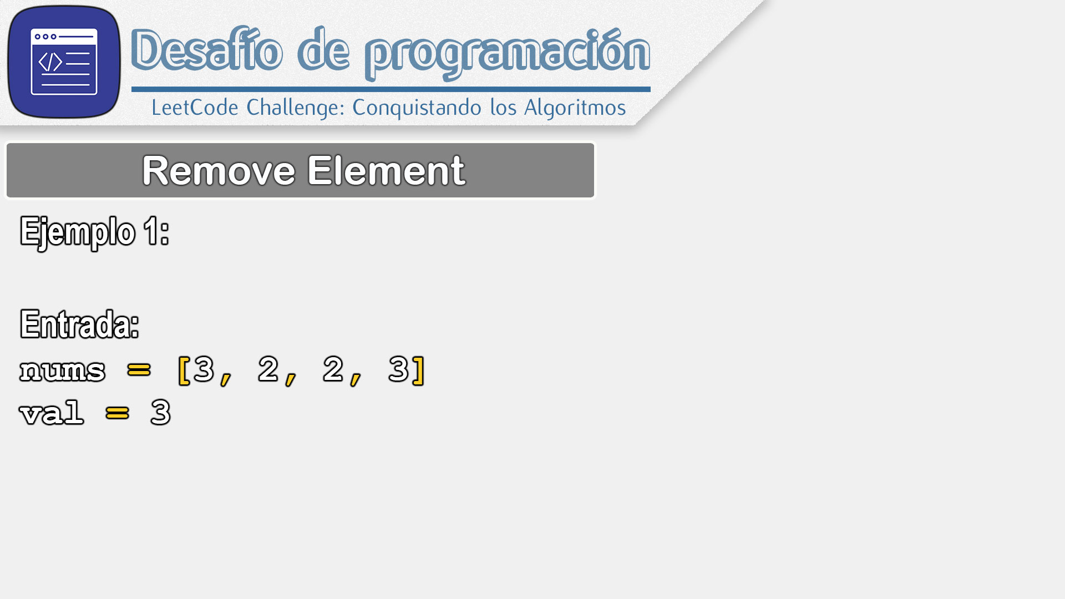

Slide 11
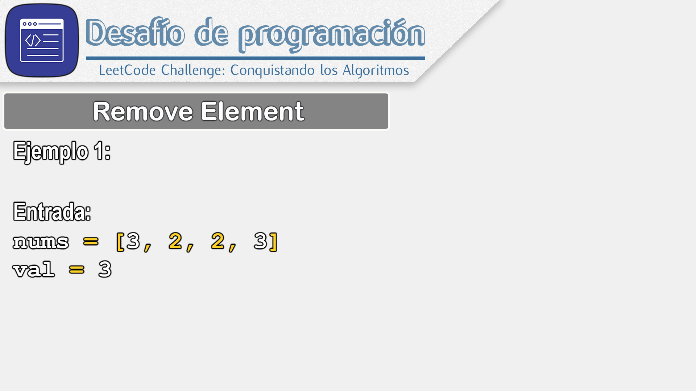

Slide 12
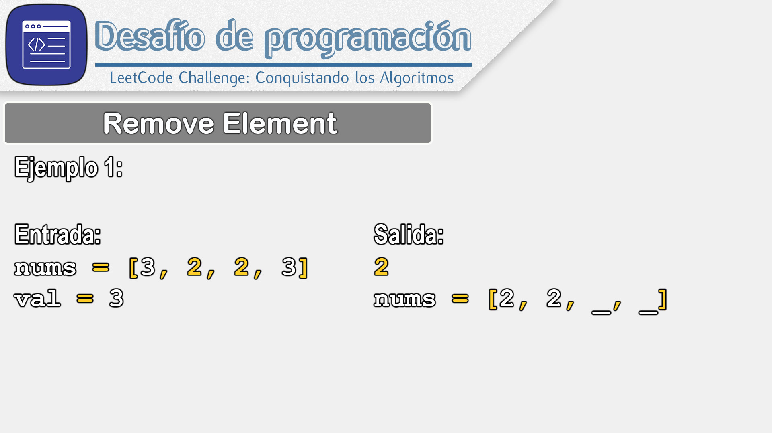

Slide 13
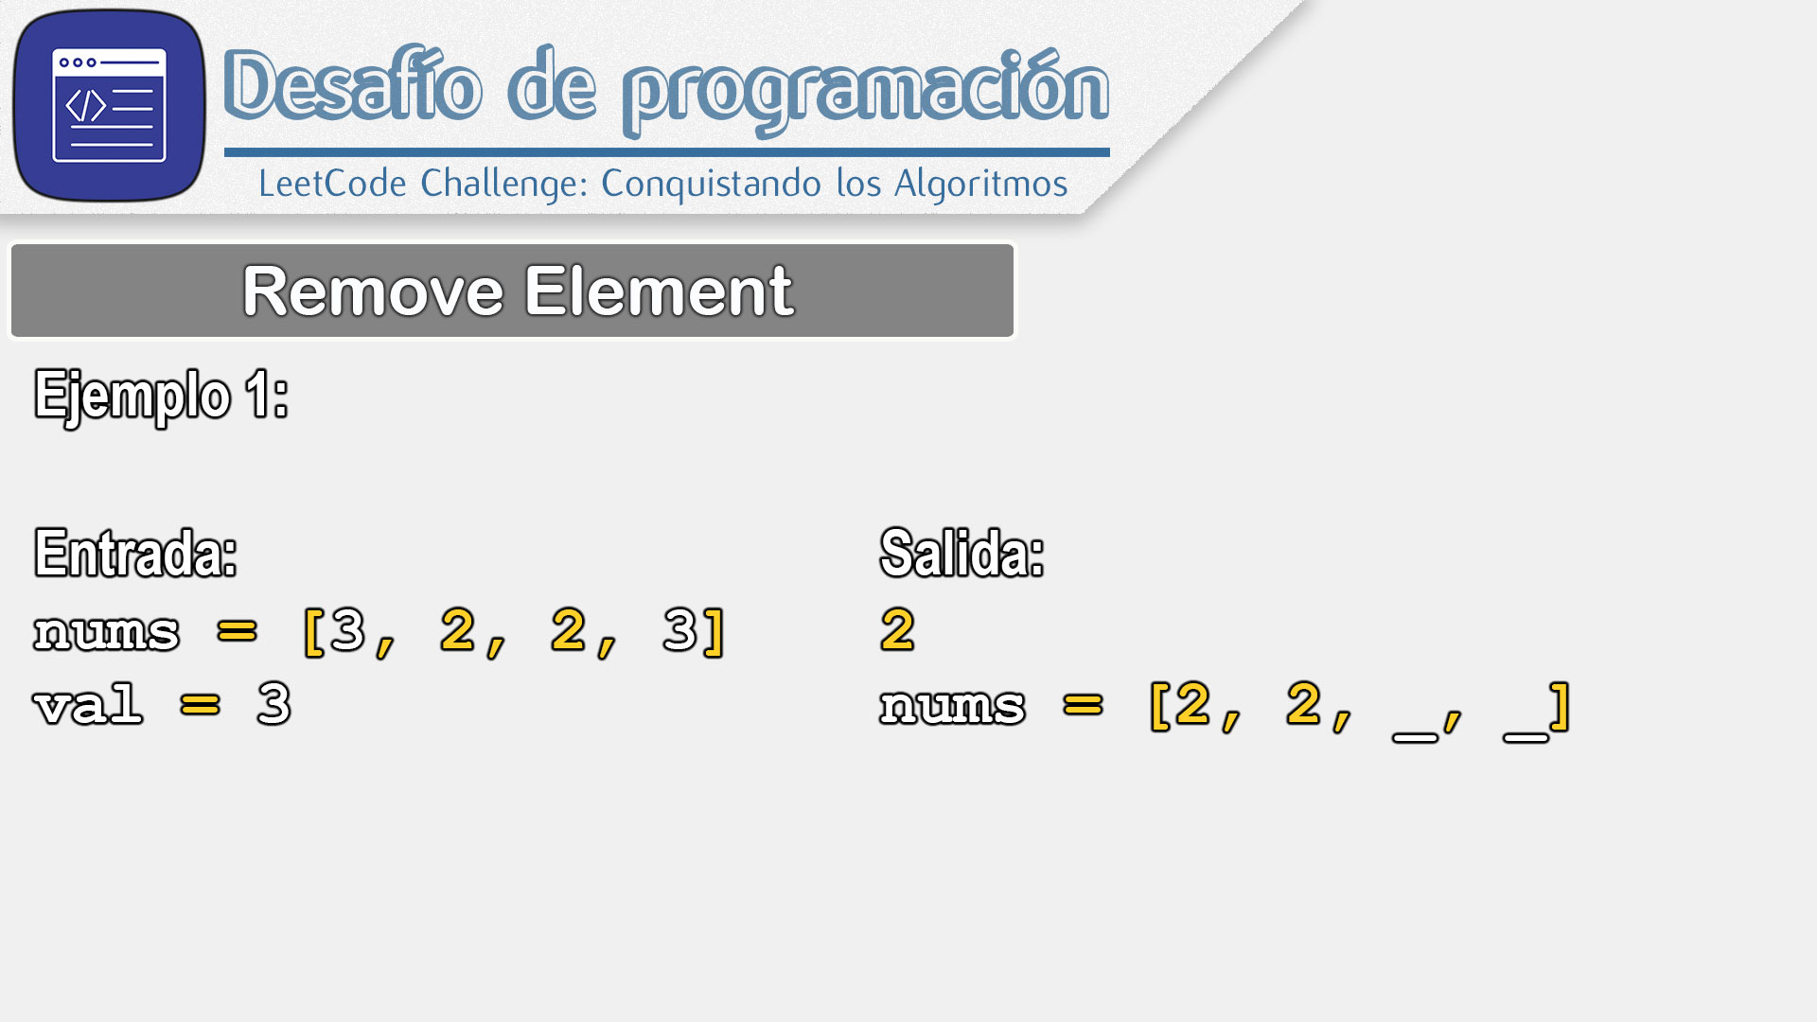

Slide 14


Slide 15
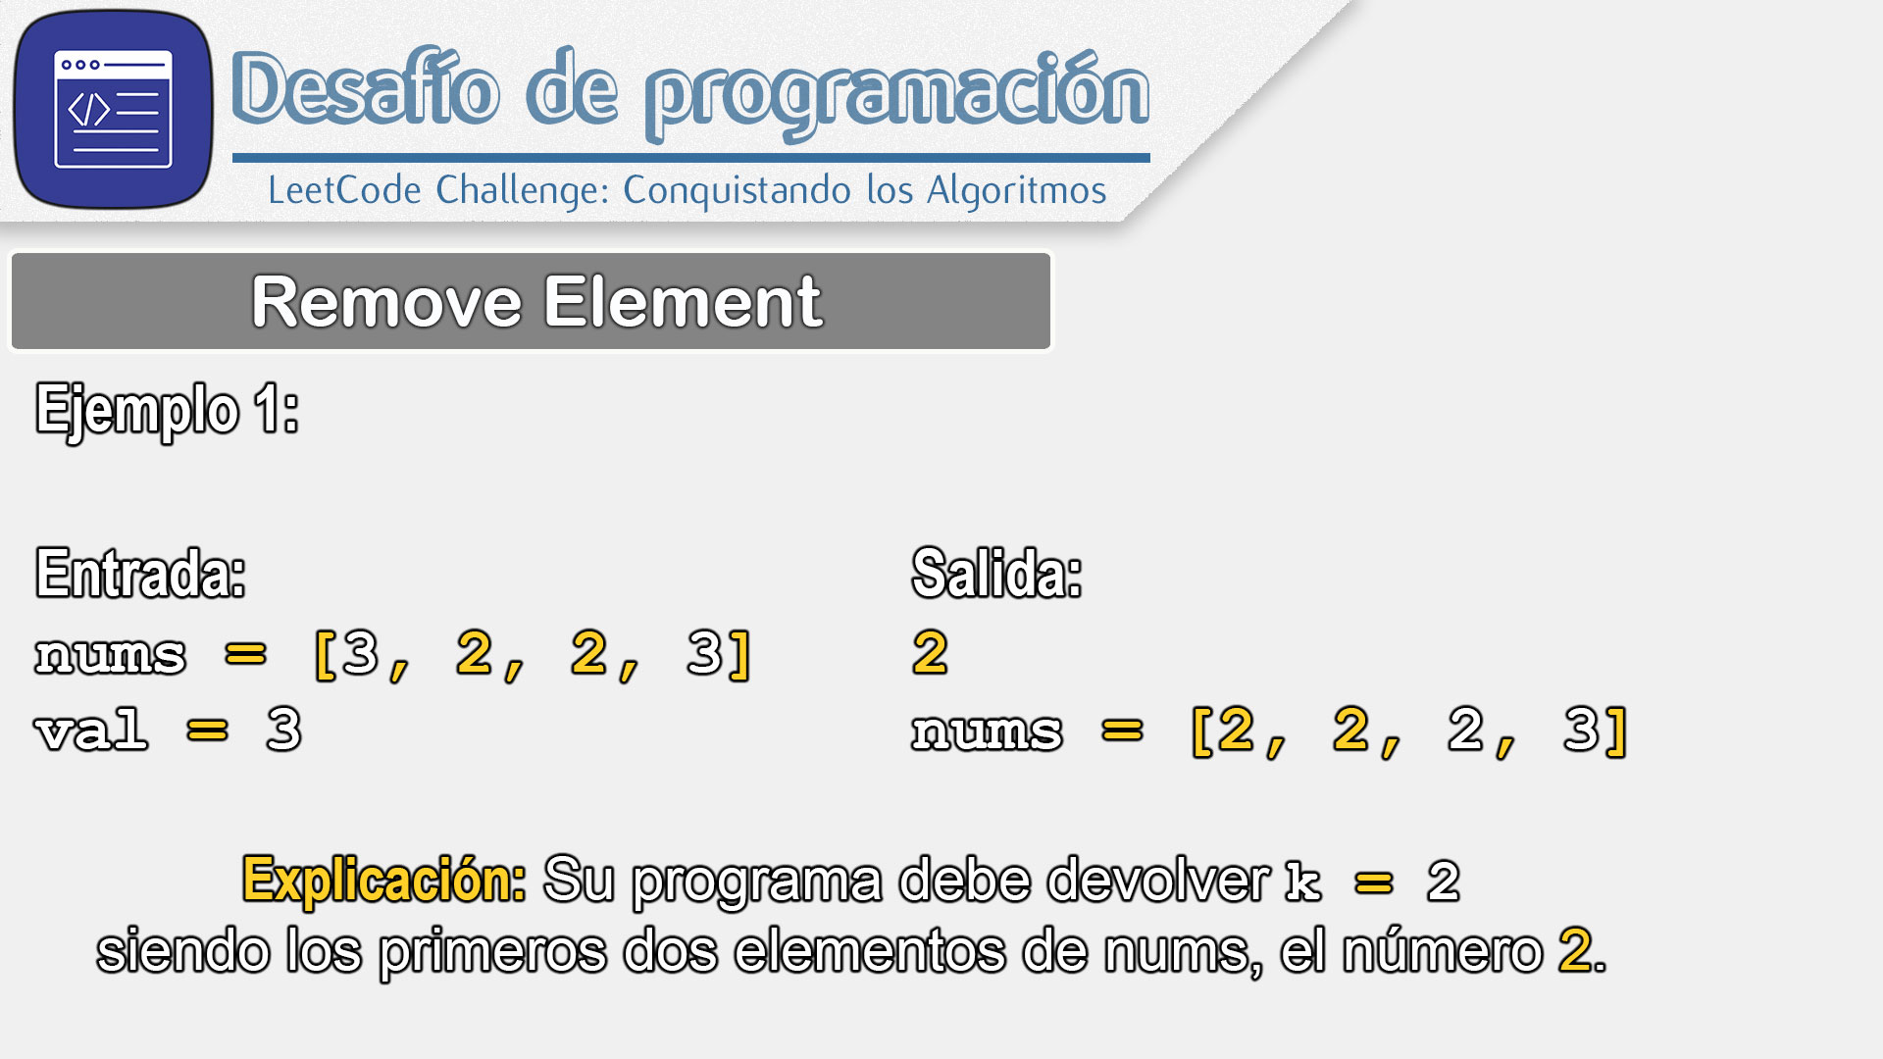

Slide 16
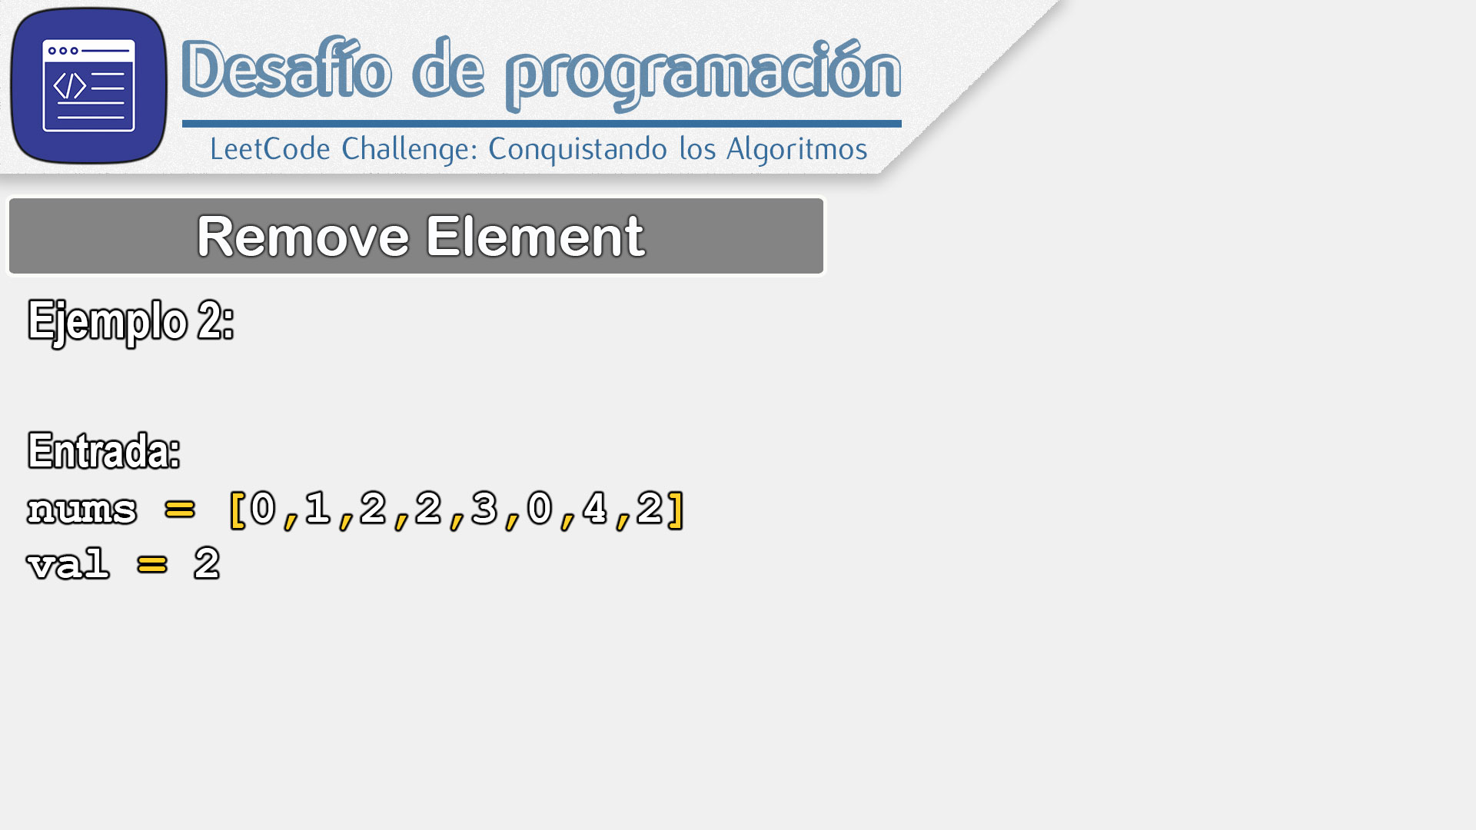

Slide 17
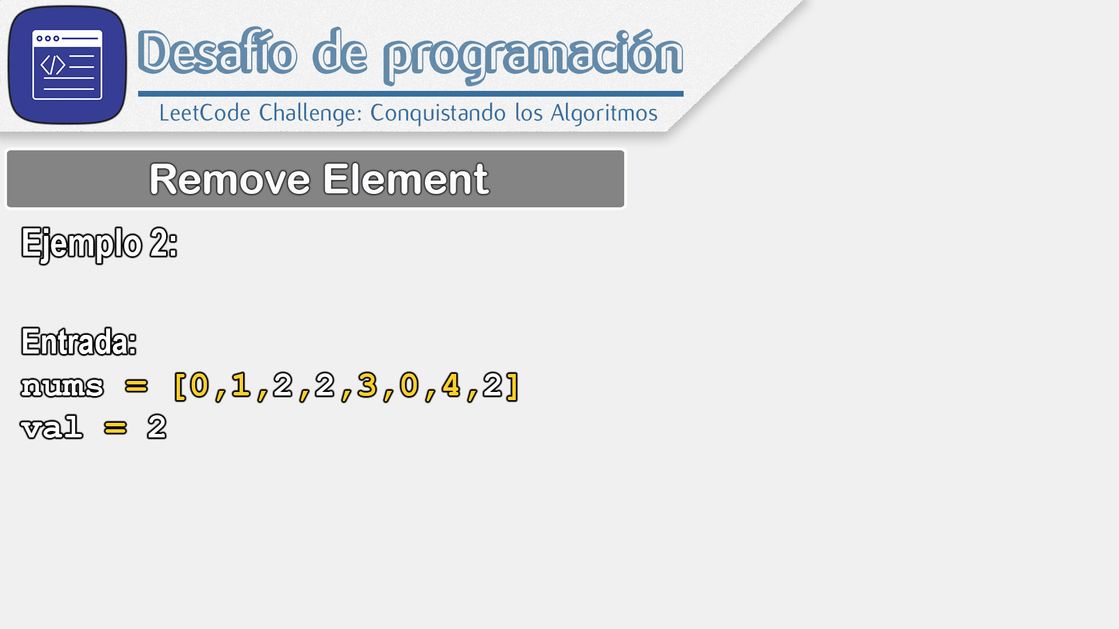

Slide 18
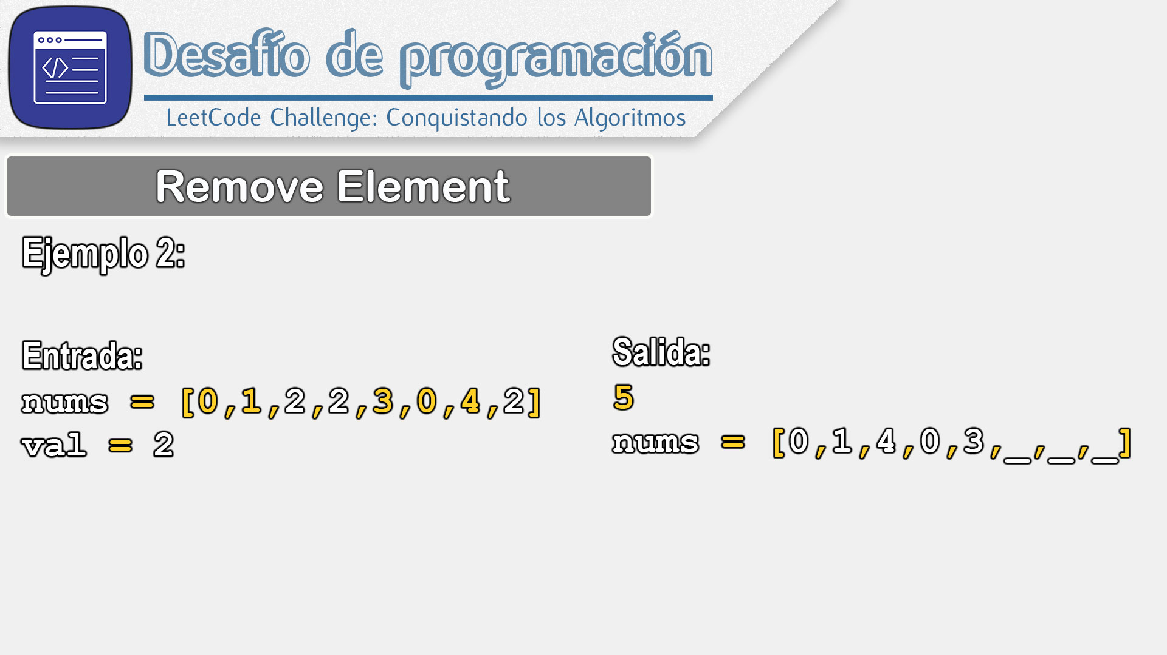

Slide 19
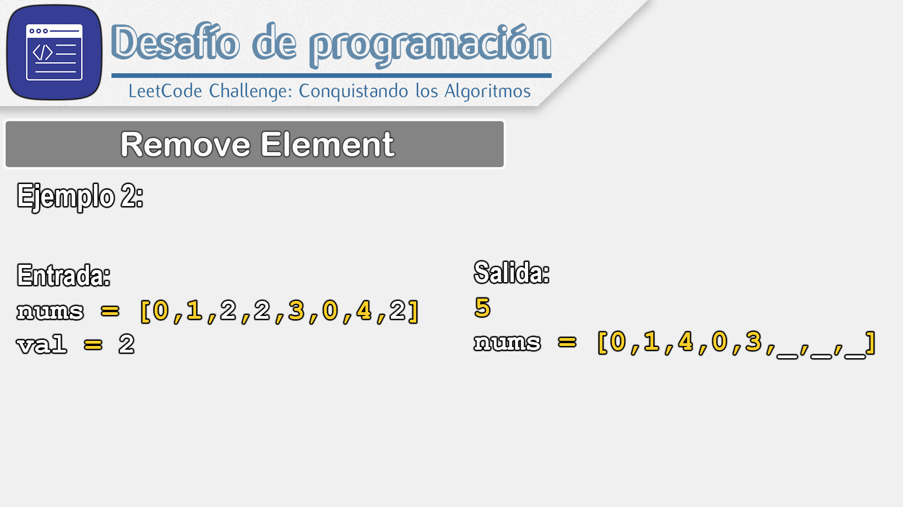

Slide 20
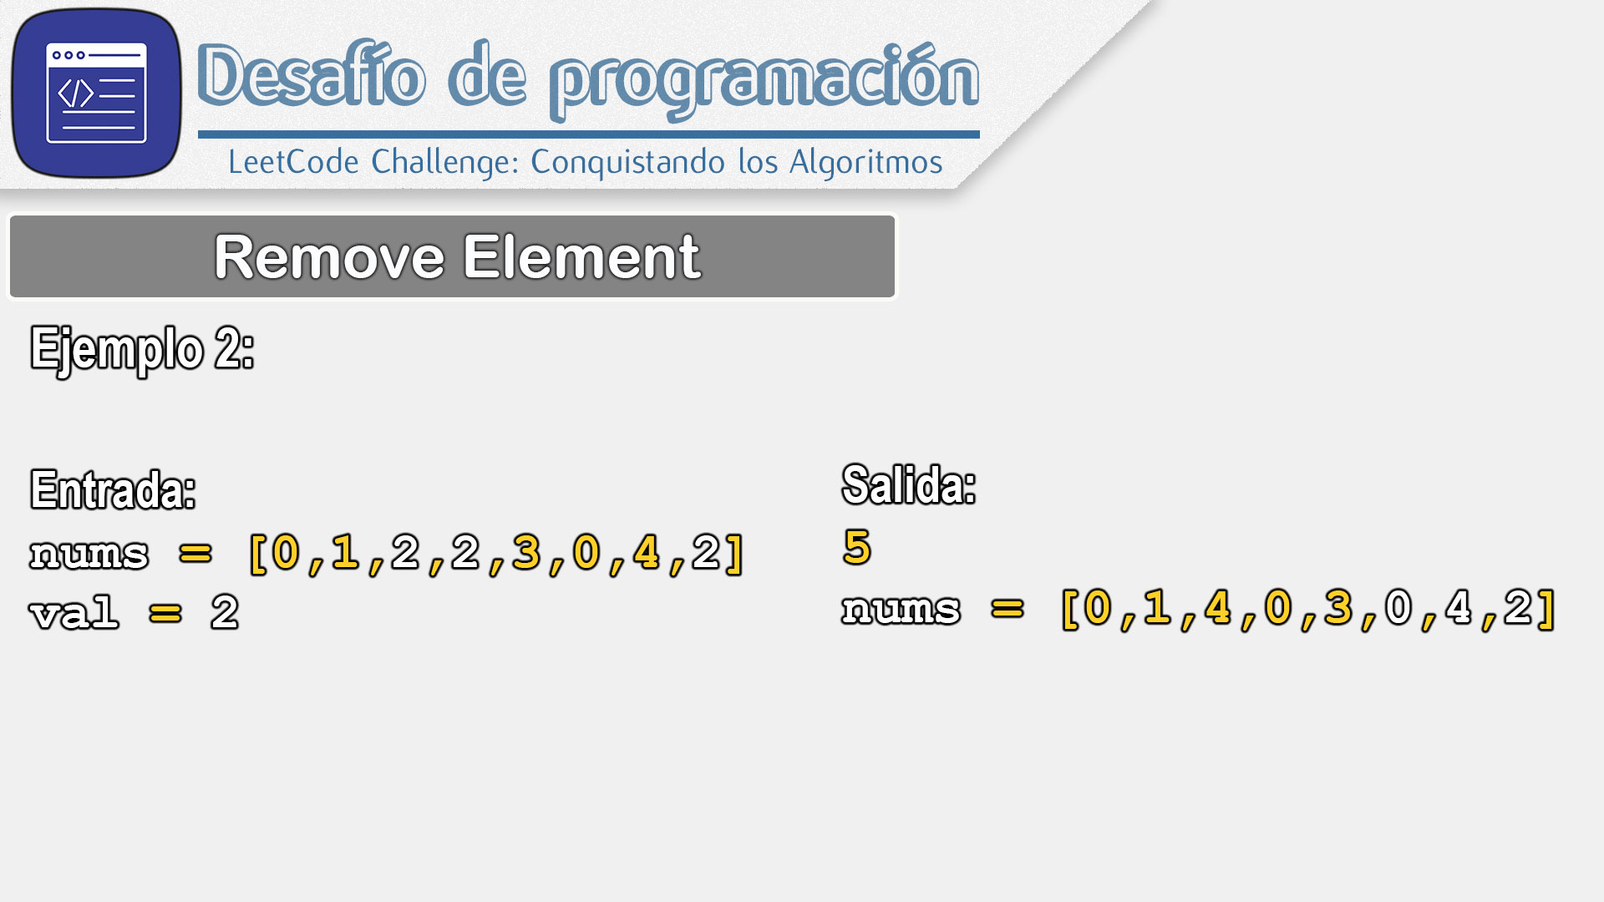

Slide 21
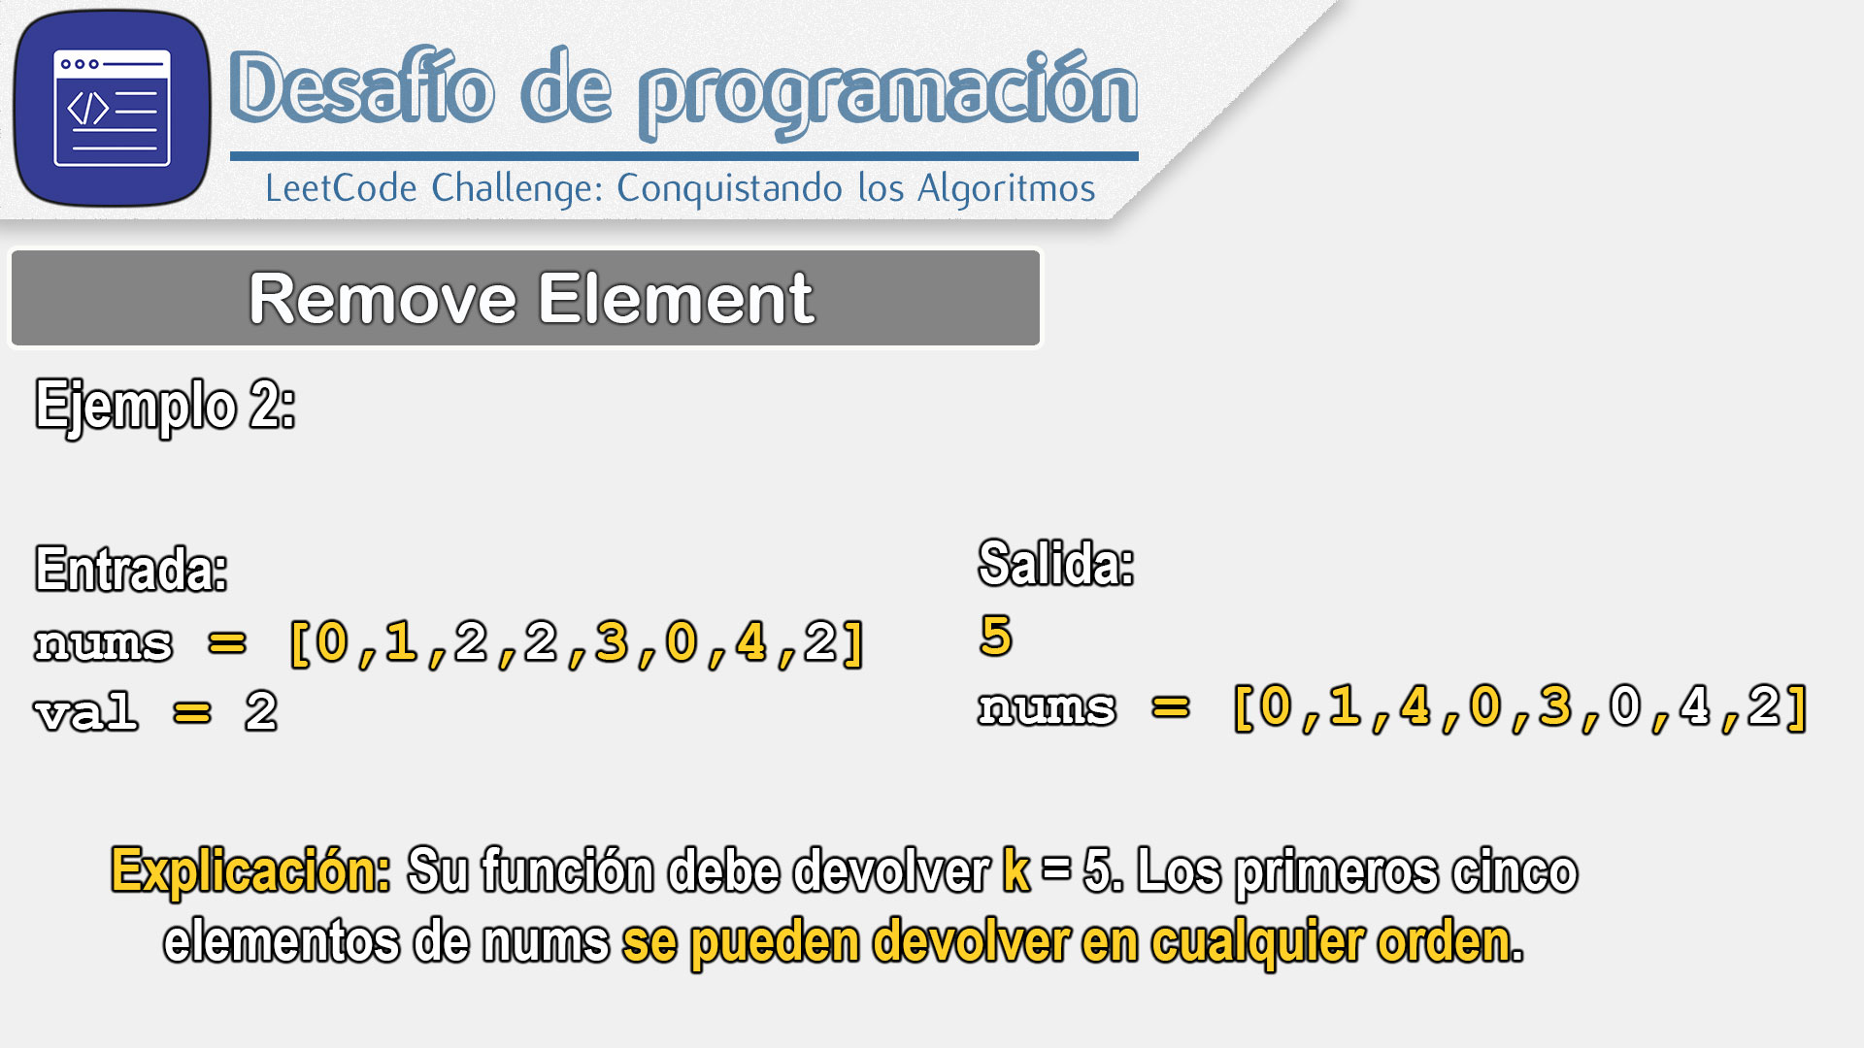

Slide 23
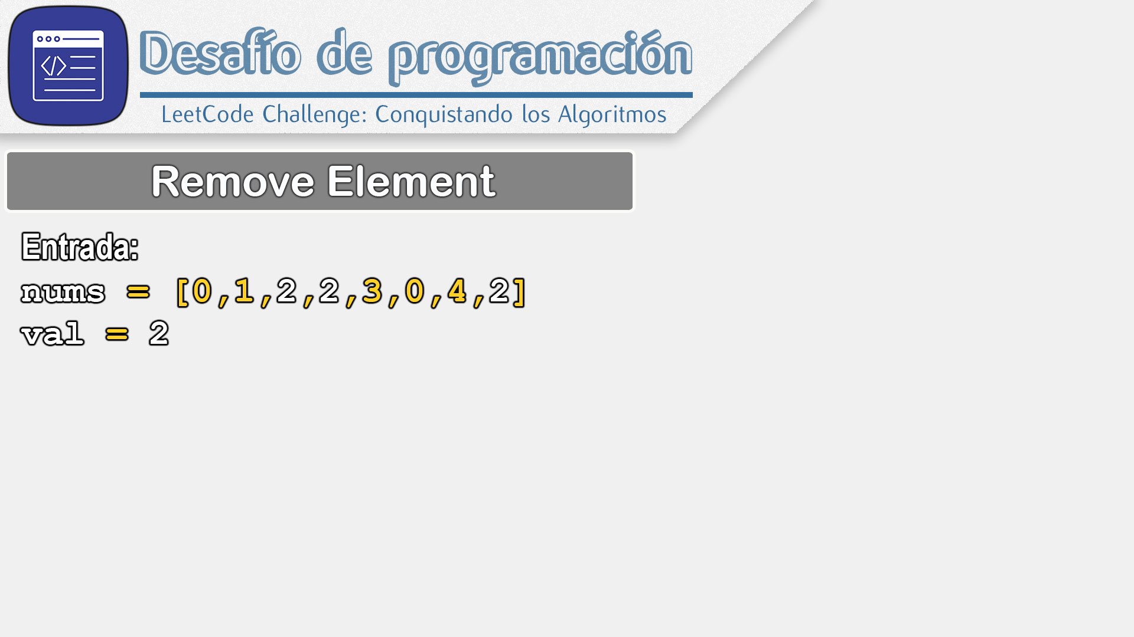
0 | 1 | 2 | 3 | 4 | 5 | 6 | 7
0 | 1 | 2 | 2 | 3 | 0 | 4 | 2

Slide 24
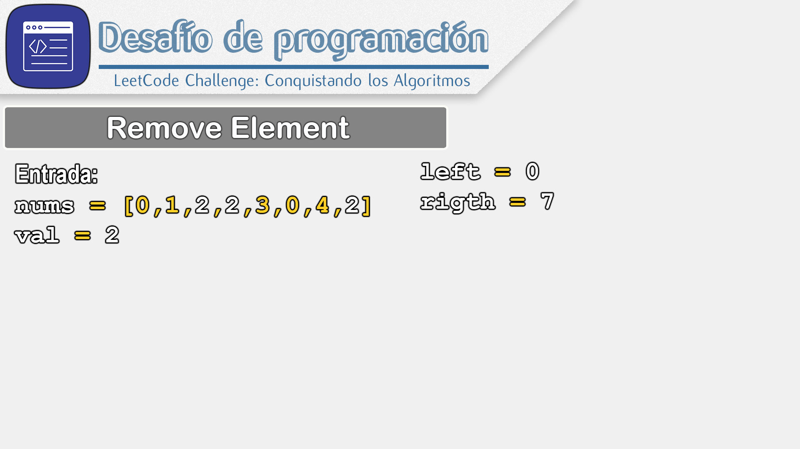
0 | 1 | 2 | 3 | 4 | 5 | 6 | 7
0 | 1 | 2 | 2 | 3 | 0 | 4 | 2

Slide 25
L
R
0 | 1 | 2 | 3 | 4 | 5 | 6 | 7
0 | 1 | 2 | 2 | 3 | 0 | 4 | 2

Slide 26
L
R
0 | 1 | 2 | 3 | 4 | 5 | 6 | 7
0 | 1 | 2 | 2 | 3 | 0 | 4 | 2

Slide 27
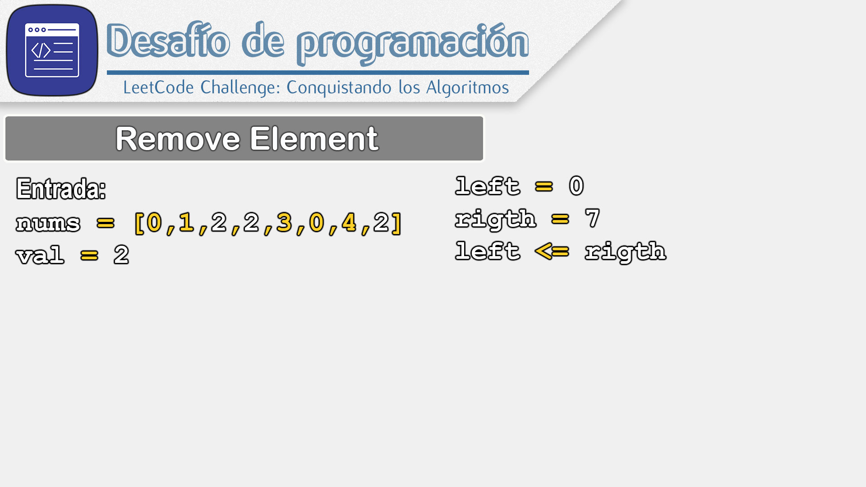
L
R
0 | 1 | 2 | 3 | 4 | 5 | 6 | 7
0 | 1 | 2 | 2 | 3 | 0 | 4 | 2

Slide 28
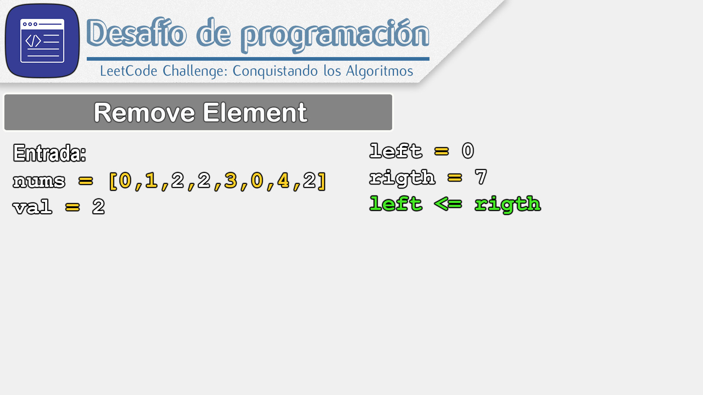
L
R
0 | 1 | 2 | 3 | 4 | 5 | 6 | 7
0 | 1 | 2 | 2 | 3 | 0 | 4 | 2

Slide 29
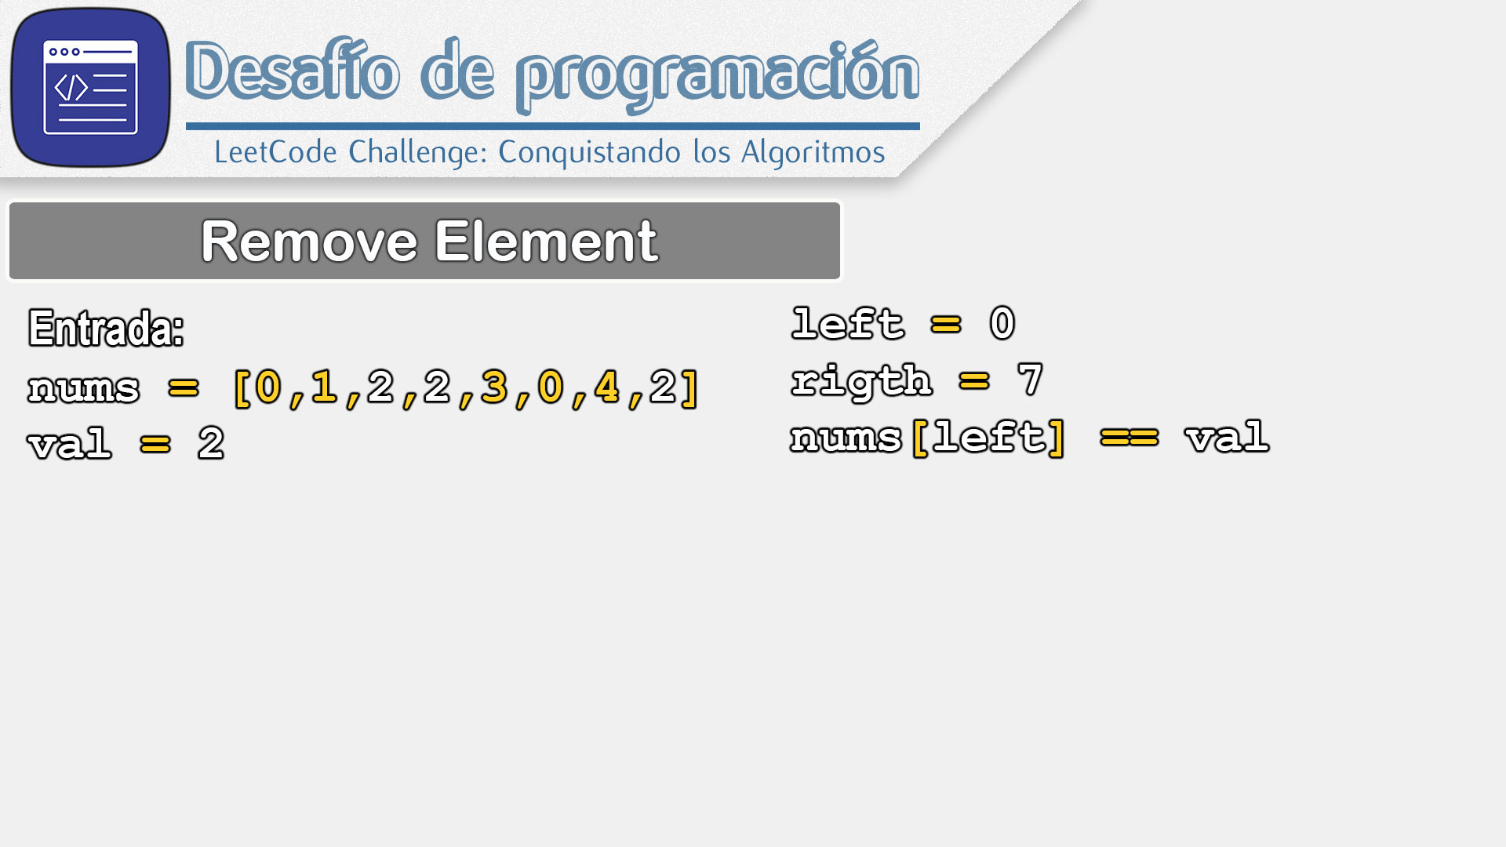
L
R
0 | 1 | 2 | 3 | 4 | 5 | 6 | 7
0 | 1 | 2 | 2 | 3 | 0 | 4 | 2

Slide 30
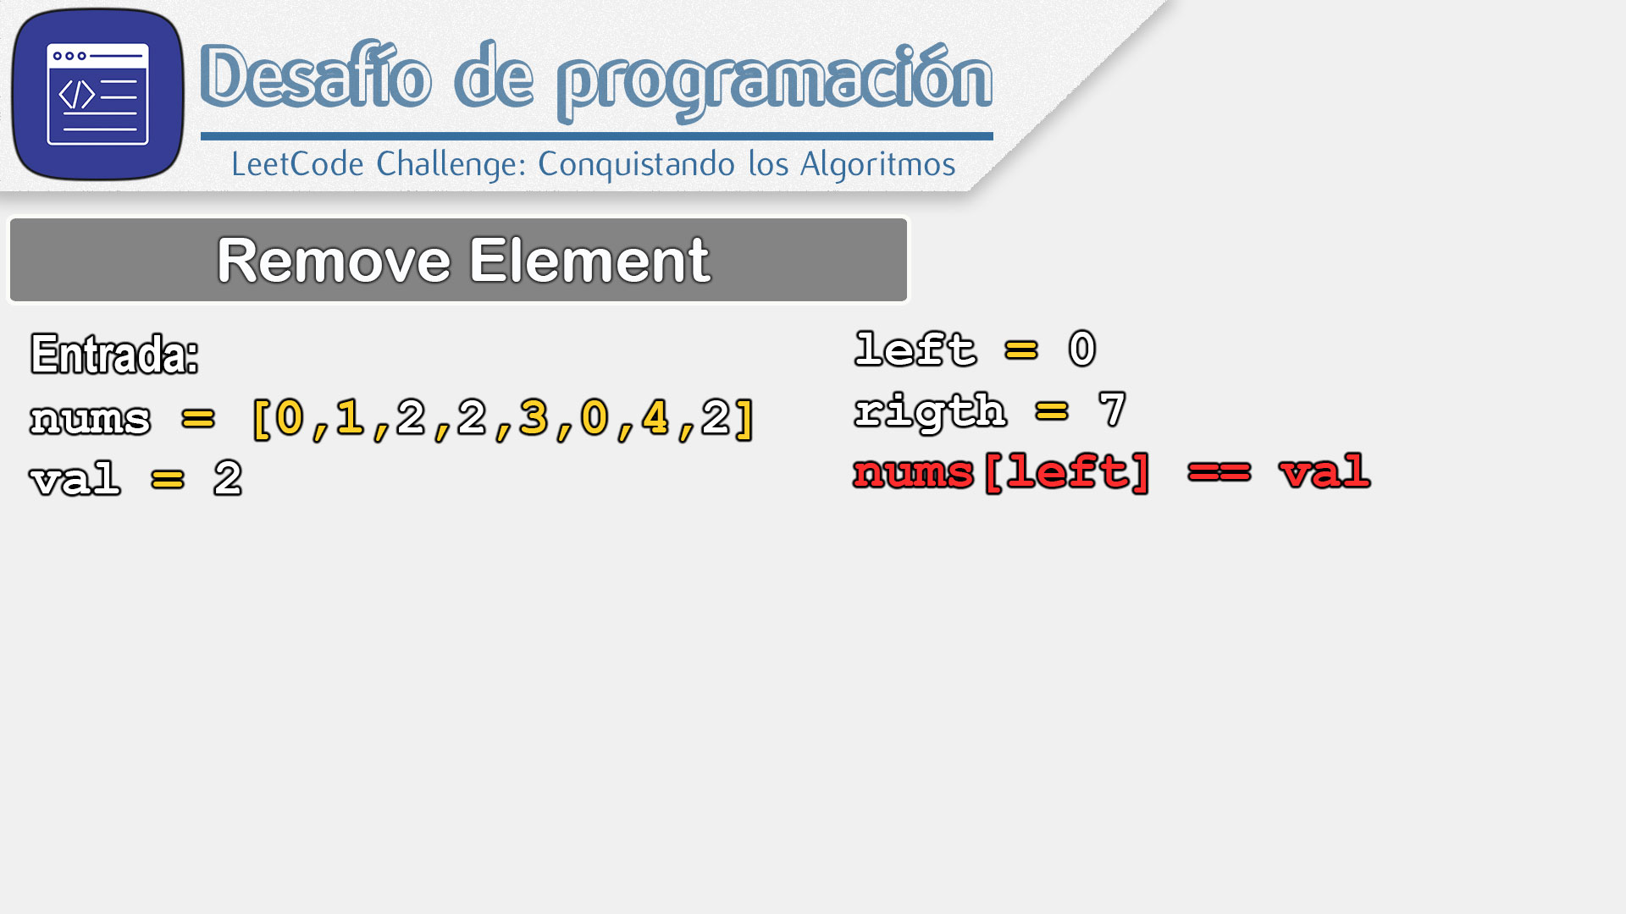
L
R
0 | 1 | 2 | 3 | 4 | 5 | 6 | 7
0 | 1 | 2 | 2 | 3 | 0 | 4 | 2

Slide 31
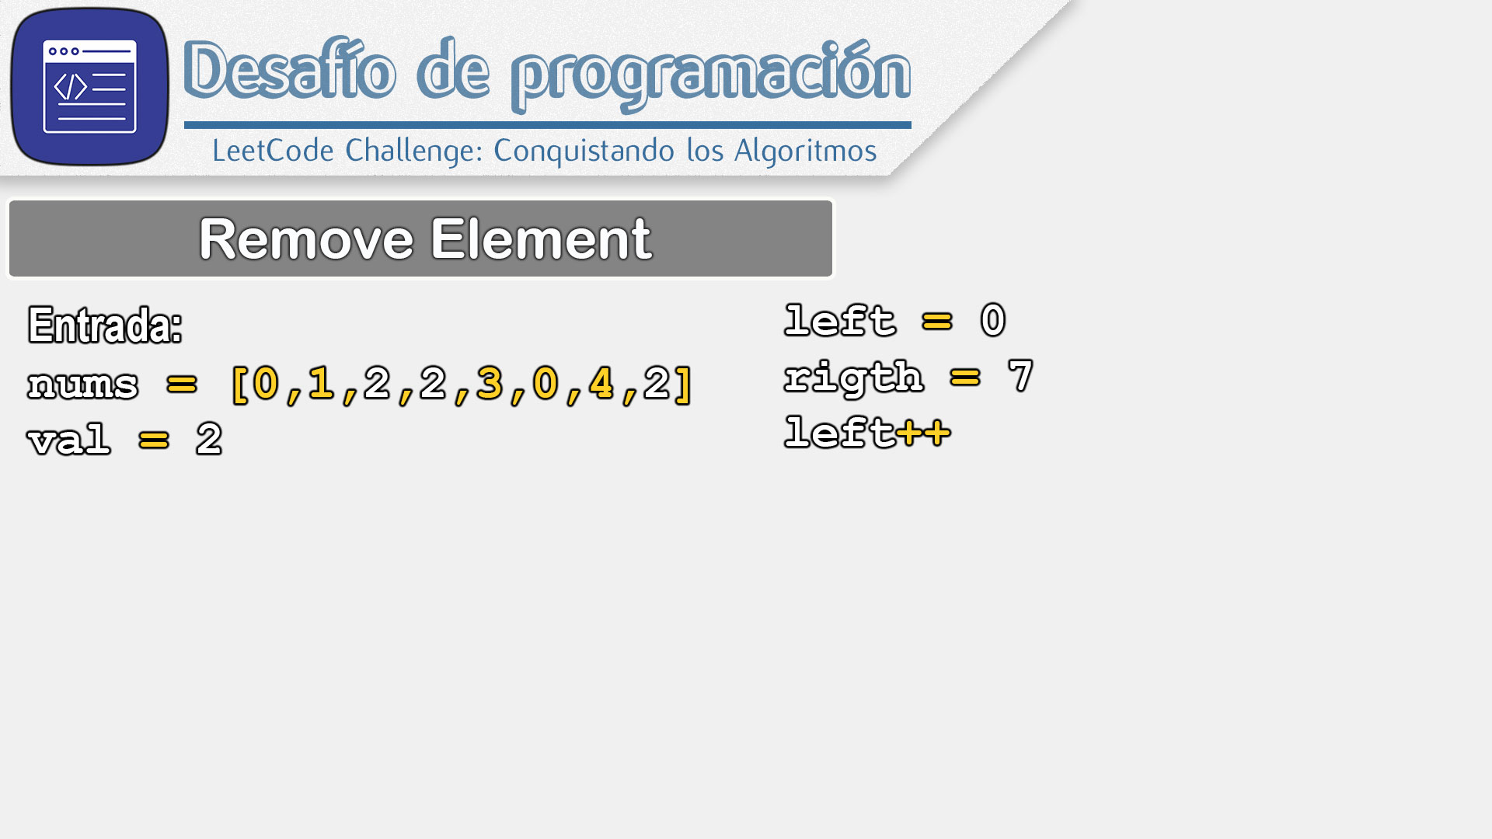
L
R
0 | 1 | 2 | 3 | 4 | 5 | 6 | 7
0 | 1 | 2 | 2 | 3 | 0 | 4 | 2

Slide 32

L
R
0 | 1 | 2 | 3 | 4 | 5 | 6 | 7
0 | 1 | 2 | 2 | 3 | 0 | 4 | 2

Slide 33
L
R
0 | 1 | 2 | 3 | 4 | 5 | 6 | 7
0 | 1 | 2 | 2 | 3 | 0 | 4 | 2

Slide 34

L
R
0 | 1 | 2 | 3 | 4 | 5 | 6 | 7
0 | 1 | 2 | 2 | 3 | 0 | 4 | 2

Slide 35

L
R
0 | 1 | 2 | 3 | 4 | 5 | 6 | 7
0 | 1 | 2 | 2 | 3 | 0 | 4 | 2

Slide 36
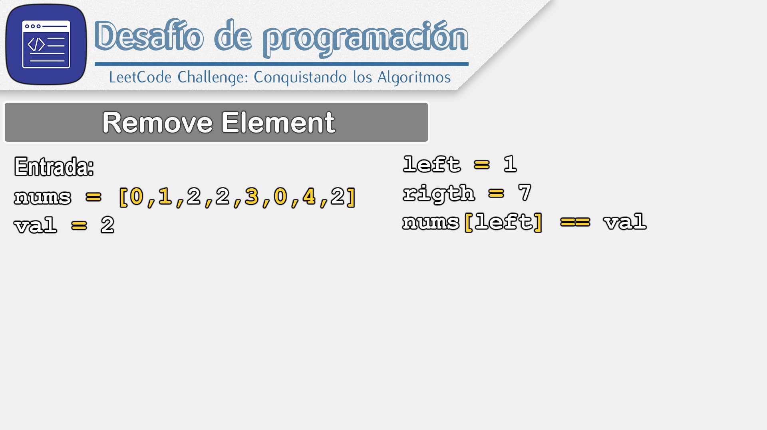
L
R
0 | 1 | 2 | 3 | 4 | 5 | 6 | 7
0 | 1 | 2 | 2 | 3 | 0 | 4 | 2

Slide 37

L
R
0 | 1 | 2 | 3 | 4 | 5 | 6 | 7
0 | 1 | 2 | 2 | 3 | 0 | 4 | 2

Slide 38
L
R
0 | 1 | 2 | 3 | 4 | 5 | 6 | 7
0 | 1 | 2 | 2 | 3 | 0 | 4 | 2

Slide 39

L
R
0 | 1 | 2 | 3 | 4 | 5 | 6 | 7
0 | 1 | 2 | 2 | 3 | 0 | 4 | 2

Slide 40
L
R
0 | 1 | 2 | 3 | 4 | 5 | 6 | 7
0 | 1 | 2 | 2 | 3 | 0 | 4 | 2

Slide 41

L
R
0 | 1 | 2 | 3 | 4 | 5 | 6 | 7
0 | 1 | 2 | 2 | 3 | 0 | 4 | 2

Slide 42

L
R
0 | 1 | 2 | 3 | 4 | 5 | 6 | 7
0 | 1 | 2 | 2 | 3 | 0 | 4 | 2

Slide 43

L
R
0 | 1 | 2 | 3 | 4 | 5 | 6 | 7
0 | 1 | 2 | 2 | 3 | 0 | 4 | 2

Slide 44
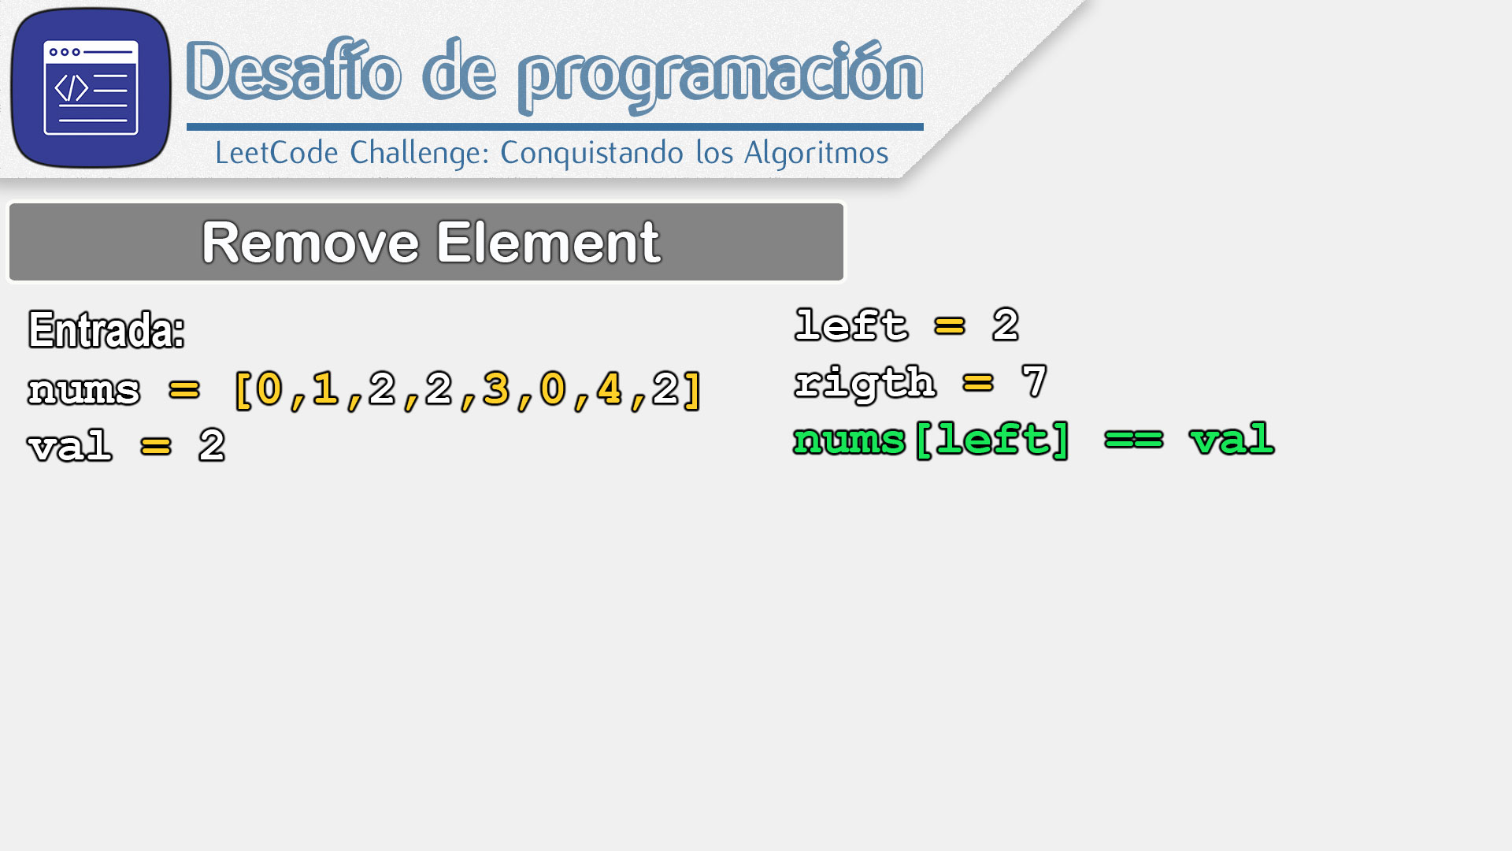
L
R
0 | 1 | 2 | 3 | 4 | 5 | 6 | 7
0 | 1 | 2 | 2 | 3 | 0 | 4 | 2

Slide 45
L
R
0 | 1 | 2 | 3 | 4 | 5 | 6 | 7
0 | 1 | 2 | 2 | 3 | 0 | 4 | 2

Slide 46
L
R
0 | 1 | 2 | 3 | 4 | 5 | 6 | 7
0 | 1 |  | 2 | 3 | 0 | 4 | 2

Slide 47
L
R
0 | 1 | 2 | 3 | 4 | 5 | 6 | 7
0 | 1 | 2 | 2 | 3 | 0 | 4 | 2

Slide 48
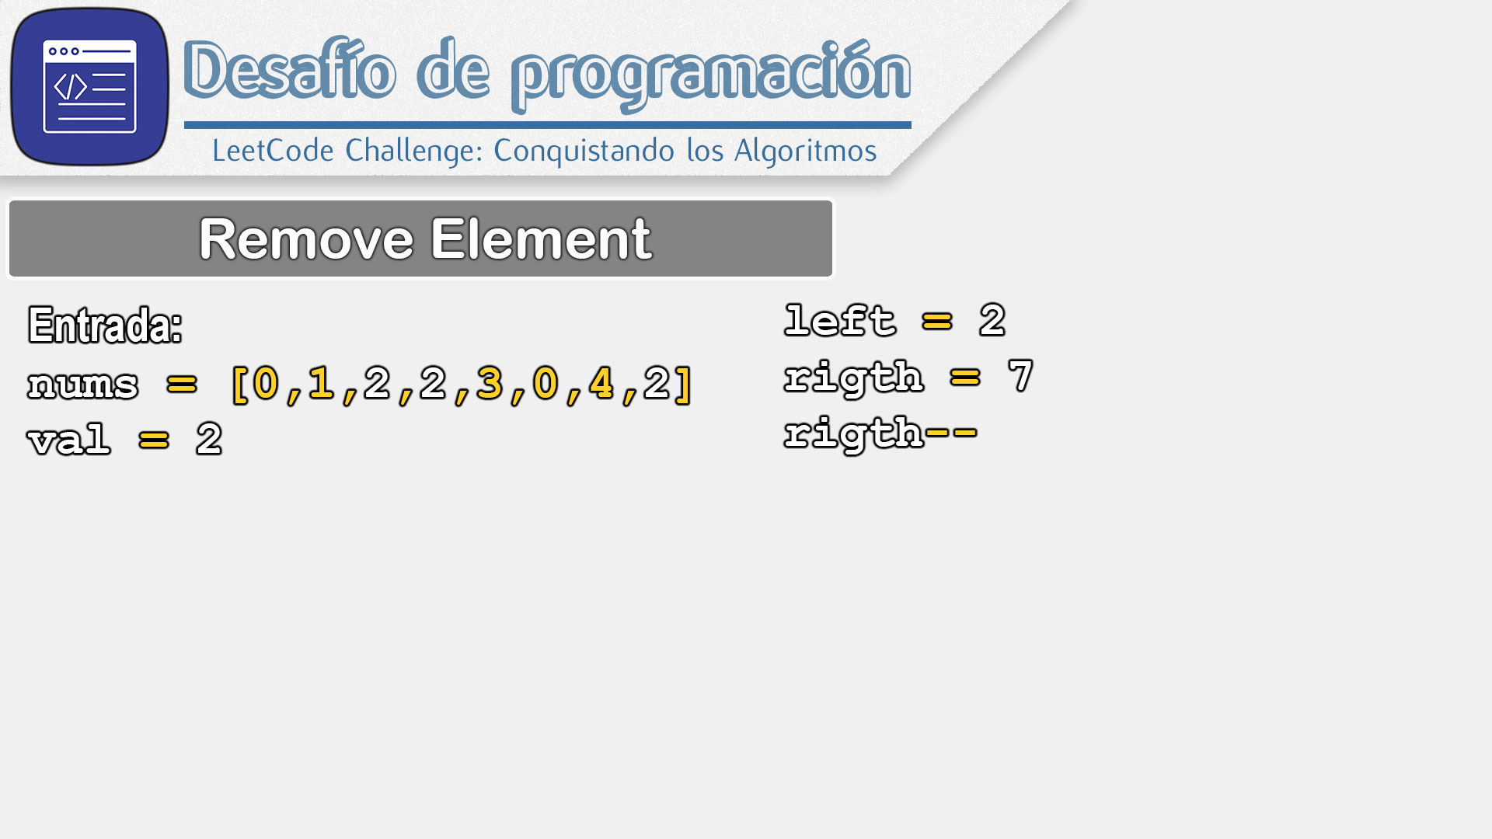
L
R
0 | 1 | 2 | 3 | 4 | 5 | 6 | 7
0 | 1 | 2 | 2 | 3 | 0 | 4 | 2

Slide 49

L
R
0 | 1 | 2 | 3 | 4 | 5 | 6 | 7
0 | 1 | 2 | 2 | 3 | 0 | 4 | 2

Slide 50
L
R
0 | 1 | 2 | 3 | 4 | 5 | 6 | 7
0 | 1 | 2 | 2 | 3 | 0 | 4 | 2

Slide 51

L
R
0 | 1 | 2 | 3 | 4 | 5 | 6 | 7
0 | 1 | 2 | 2 | 3 | 0 | 4 | 2

Slide 52

L
R
0 | 1 | 2 | 3 | 4 | 5 | 6 | 7
0 | 1 | 2 | 2 | 3 | 0 | 4 | 2

Slide 53

L
R
0 | 1 | 2 | 3 | 4 | 5 | 6 | 7
0 | 1 | 2 | 2 | 3 | 0 | 4 | 2

Slide 54

L
R
0 | 1 | 2 | 3 | 4 | 5 | 6 | 7
0 | 1 | 2 | 2 | 3 | 0 | 4 | 2

Slide 55
L
R
0 | 1 | 2 | 3 | 4 | 5 | 6 | 7
0 | 1 | 2 | 2 | 3 | 0 | 4 | 2

Slide 56
L
R
0 | 1 | 2 | 3 | 4 | 5 | 6 | 7
0 | 1 |  | 2 | 3 | 0 | 4 | 2

Slide 57
L
R
0 | 1 | 2 | 3 | 4 | 5 | 6 | 7
0 | 1 | 4 | 2 | 3 | 0 | 4 | 2

Slide 58
L
R
0 | 1 | 2 | 3 | 4 | 5 | 6 | 7
0 | 1 | 4 | 2 | 3 | 0 | 4 | 2

Slide 59
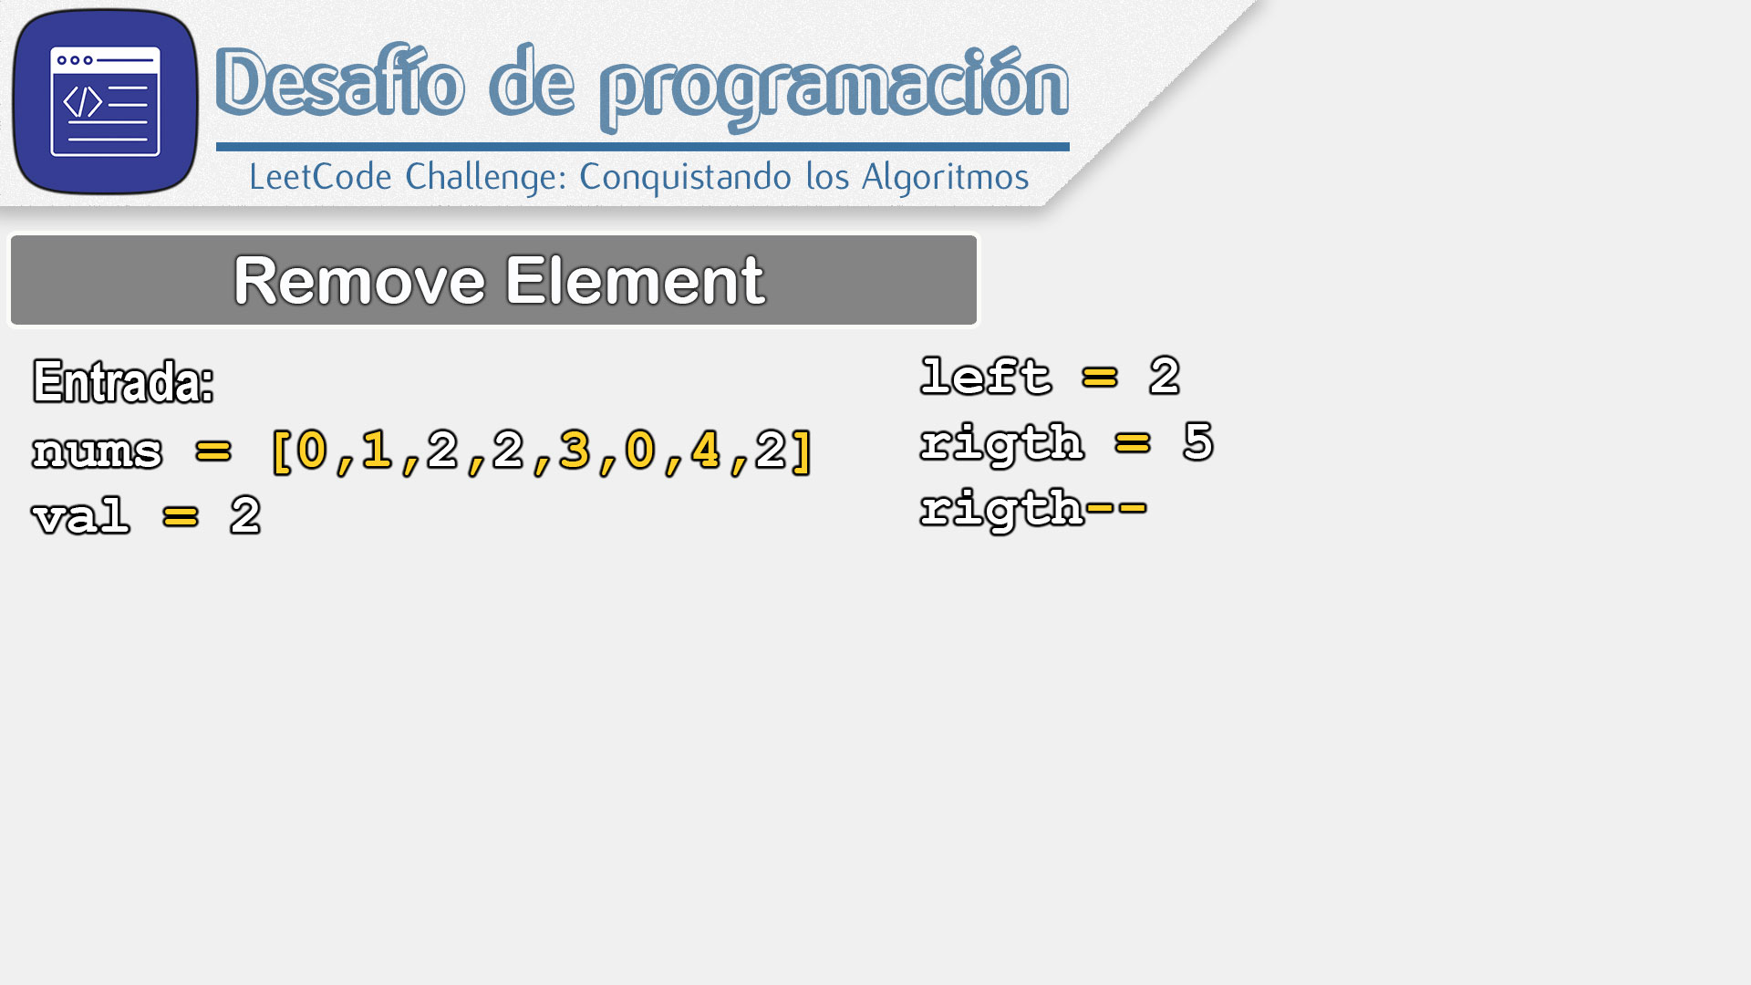
L
R
0 | 1 | 2 | 3 | 4 | 5 | 6 | 7
0 | 1 | 4 | 2 | 3 | 0 | 4 | 2

Slide 60
L
R
0 | 1 | 2 | 3 | 4 | 5 | 6 | 7
0 | 1 | 4 | 2 | 3 | 0 | 4 | 2

Slide 61

L
R
0 | 1 | 2 | 3 | 4 | 5 | 6 | 7
0 | 1 | 4 | 2 | 3 | 0 | 4 | 2

Slide 62

L
R
0 | 1 | 2 | 3 | 4 | 5 | 6 | 7
0 | 1 | 4 | 2 | 3 | 0 | 4 | 2

Slide 63

L
R
0 | 1 | 2 | 3 | 4 | 5 | 6 | 7
0 | 1 | 4 | 2 | 3 | 0 | 4 | 2

Slide 64

L
R
0 | 1 | 2 | 3 | 4 | 5 | 6 | 7
0 | 1 | 4 | 2 | 3 | 0 | 4 | 2

Slide 65

L
R
0 | 1 | 2 | 3 | 4 | 5 | 6 | 7
0 | 1 | 4 | 2 | 3 | 0 | 4 | 2

Slide 66

L
R
0 | 1 | 2 | 3 | 4 | 5 | 6 | 7
0 | 1 | 4 | 2 | 3 | 0 | 4 | 2

Slide 67
L
R
0 | 1 | 2 | 3 | 4 | 5 | 6 | 7
0 | 1 | 4 | 2 | 3 | 0 | 4 | 2

Slide 68

L
R
0 | 1 | 2 | 3 | 4 | 5 | 6 | 7
0 | 1 | 4 | 2 | 3 | 0 | 4 | 2

Slide 69

L
R
0 | 1 | 2 | 3 | 4 | 5 | 6 | 7
0 | 1 | 4 | 2 | 3 | 0 | 4 | 2

Slide 70

L
R
0 | 1 | 2 | 3 | 4 | 5 | 6 | 7
0 | 1 | 4 | 2 | 3 | 0 | 4 | 2

Slide 71

L
R
0 | 1 | 2 | 3 | 4 | 5 | 6 | 7
0 | 1 | 4 | 2 | 3 | 0 | 4 | 2

Slide 72
L
R
0 | 1 | 2 | 3 | 4 | 5 | 6 | 7
0 | 1 | 4 | 2 | 3 | 0 | 4 | 2

Slide 73
L
R
0 | 1 | 2 | 3 | 4 | 5 | 6 | 7
0 | 1 | 4 |  | 3 | 0 | 4 | 2

Slide 74
L
R
0 | 1 | 2 | 3 | 4 | 5 | 6 | 7
0 | 1 | 4 | 0 | 3 | 0 | 4 | 2

Slide 75

L
R
0 | 1 | 2 | 3 | 4 | 5 | 6 | 7
0 | 1 | 4 | 0 | 3 | 0 | 4 | 2

Slide 76

L
R
0 | 1 | 2 | 3 | 4 | 5 | 6 | 7
0 | 1 | 4 | 0 | 3 | 0 | 4 | 2

Slide 77
L
R
0 | 1 | 2 | 3 | 4 | 5 | 6 | 7
0 | 1 | 4 | 0 | 3 | 0 | 4 | 2

Slide 78

L
R
0 | 1 | 2 | 3 | 4 | 5 | 6 | 7
0 | 1 | 4 | 0 | 3 | 0 | 4 | 2

Slide 79

L
R
0 | 1 | 2 | 3 | 4 | 5 | 6 | 7
0 | 1 | 4 | 0 | 3 | 0 | 4 | 2

Slide 80

L
R
0 | 1 | 2 | 3 | 4 | 5 | 6 | 7
0 | 1 | 4 | 0 | 3 | 0 | 4 | 2

Slide 81

L
R
0 | 1 | 2 | 3 | 4 | 5 | 6 | 7
0 | 1 | 4 | 0 | 3 | 0 | 4 | 2

Slide 82

L
R
0 | 1 | 2 | 3 | 4 | 5 | 6 | 7
0 | 1 | 4 | 0 | 3 | 0 | 4 | 2

Slide 83

L
R
0 | 1 | 2 | 3 | 4 | 5 | 6 | 7
0 | 1 | 4 | 0 | 3 | 0 | 4 | 2

Slide 84
L
R
0 | 1 | 2 | 3 | 4 | 5 | 6 | 7
0 | 1 | 4 | 0 | 3 | 0 | 4 | 2

Slide 85

L
R
0 | 1 | 2 | 3 | 4 | 5 | 6 | 7
0 | 1 | 4 | 0 | 3 | 0 | 4 | 2

Slide 86

L
R
0 | 1 | 2 | 3 | 4 | 5 | 6 | 7
0 | 1 | 4 | 0 | 3 | 0 | 4 | 2

Slide 87

L
R
0 | 1 | 2 | 3 | 4 | 5 | 6 | 7
0 | 1 | 4 | 0 | 3 | 0 | 4 | 2

Slide 88

L
R
0 | 1 | 2 | 3 | 4 | 5 | 6 | 7
0 | 1 | 4 | 0 | 3 | 0 | 4 | 2

Slide 89
L
R
0 | 1 | 2 | 3 | 4 | 5 | 6 | 7
0 | 1 | 4 | 0 | 3 | 0 | 4 | 2

Slide 90

L
R
0 | 1 | 2 | 3 | 4 | 5 | 6 | 7
0 | 1 | 4 | 0 | 3 | 0 | 4 | 2

Slide 91
R
L
0 | 1 | 2 | 3 | 4 | 5 | 6 | 7
0 | 1 | 4 | 0 | 3 | 0 | 4 | 2

Slide 92

R
L
0 | 1 | 2 | 3 | 4 | 5 | 6 | 7
0 | 1 | 4 | 0 | 3 | 0 | 4 | 2

Slide 93
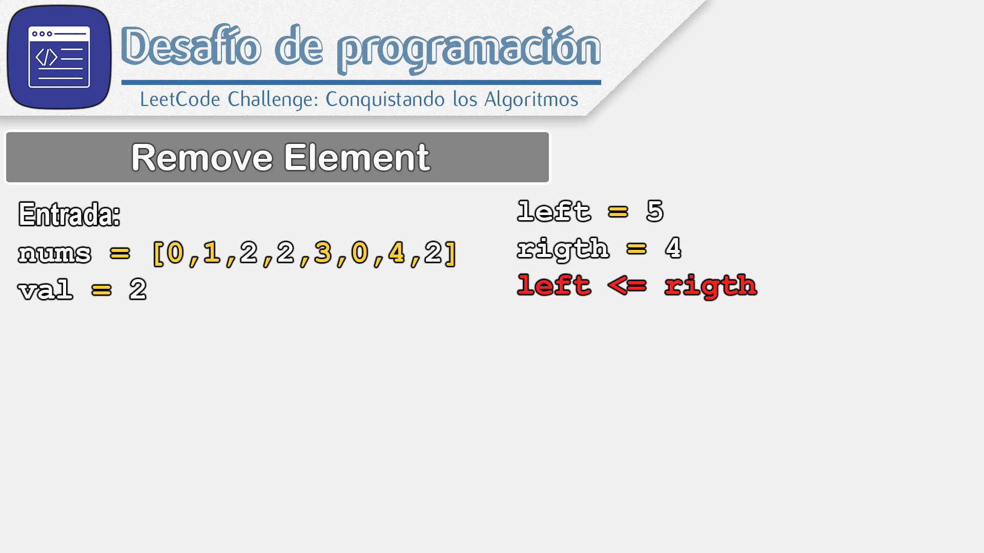
R
L
0 | 1 | 2 | 3 | 4 | 5 | 6 | 7
0 | 1 | 4 | 0 | 3 | 0 | 4 | 2

Slide 94

R
L
0 | 1 | 2 | 3 | 4 | 5 | 6 | 7
0 | 1 | 4 | 0 | 3 | 0 | 4 | 2

Slide 95
R
L
0 | 1 | 2 | 3 | 4 | 5 | 6 | 7
0 | 1 | 4 | 0 | 3 | 0 | 4 | 2

Slide 96
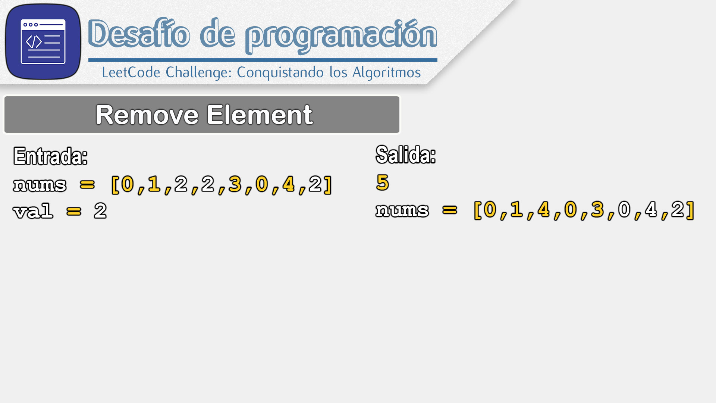
R
L
0 | 1 | 2 | 3 | 4 | 5 | 6 | 7
0 | 1 | 4 | 0 | 3 | 0 | 4 | 2

